Slide 1
Electronic Mail in the Internet
Presented By :- Snehal Tawar

Slide 2


Table Of Contents :- 1) Introduction 2) Architecture a) User Agent b) Message Transfer Agent c) Message Access Agent d) MIME 3) Web-Based E-Mail 4) E-Mail Security

Slide 3
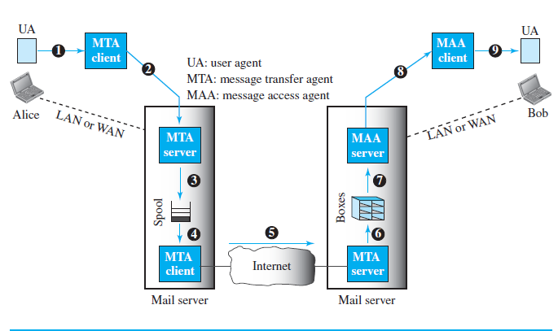
Architecture:
Electronic mail (or e-mail) allows users to exchange messages.
It is considered a one-way transaction.
The electronic mail system needs two UAs, two pairs of MTAs (client and server), and a pair of MAAs (client and server).

Slide 4

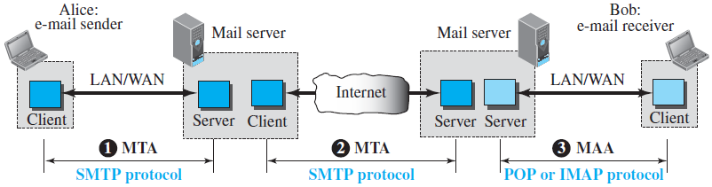
User agent : It can be command driven(old) or GUI based. The envelope usually contains the sender address, the receiver address, and other information. When receiving mail the UA informs the user with a notice. A summary usually includes the sender mail address, the subject, and the time the mail was sent or received. Electronic mail allows one name, an alias, to represent several different e-mail addresses; this is called a mailing list.
Message Transfer Agent: SMTP uses commands and responses to transfer messages between an MTA client and an MTA server. The command is from an MTA client to an MTA server; the response is from an MTA server to the MTA client.

Slide 5
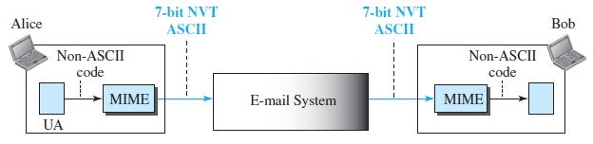
Message Access Agent: SMTP is a push protocol while the third phase requires a pull protocol. The server Post Office Protocol, version 3 (POP3) software is installed on the mail server. Another mail access protocol is Internet Mail Access Protocol, version 4 (IMAP4) it has more features; is more powerful and more complex.
MIME: Multipurpose Internet Mail Extensions (MIME) is a supplementary protocol that allows non-ASCII data to be sent through e-mail. It transforms non-ASCII data to ASCII data and vice versa
Web-Based Mail: E-mail is such a common application that some websites like Hotmail, Yahoo, and Google mail today provide this service to anyone who accesses the site.

Slide 6
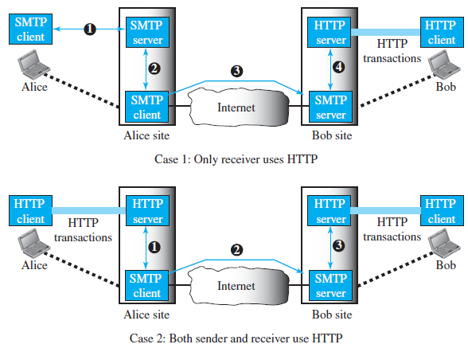
E-Mail Security: Pretty Good Privacy (PGP) was invented by Phil Zimmermann to provide e-mail with privacy, integrity, and authentication. Secure/Multipurpose Internet Mail Extension (S/MIME) has defined Cryptographic Message Syntax (CMS).The syntax in each case defines the exact encoding scheme for each content type.

Slide 7

THANK YOU !

